Slide 1
NGSS
Next Generation Science Standards

Slide 2
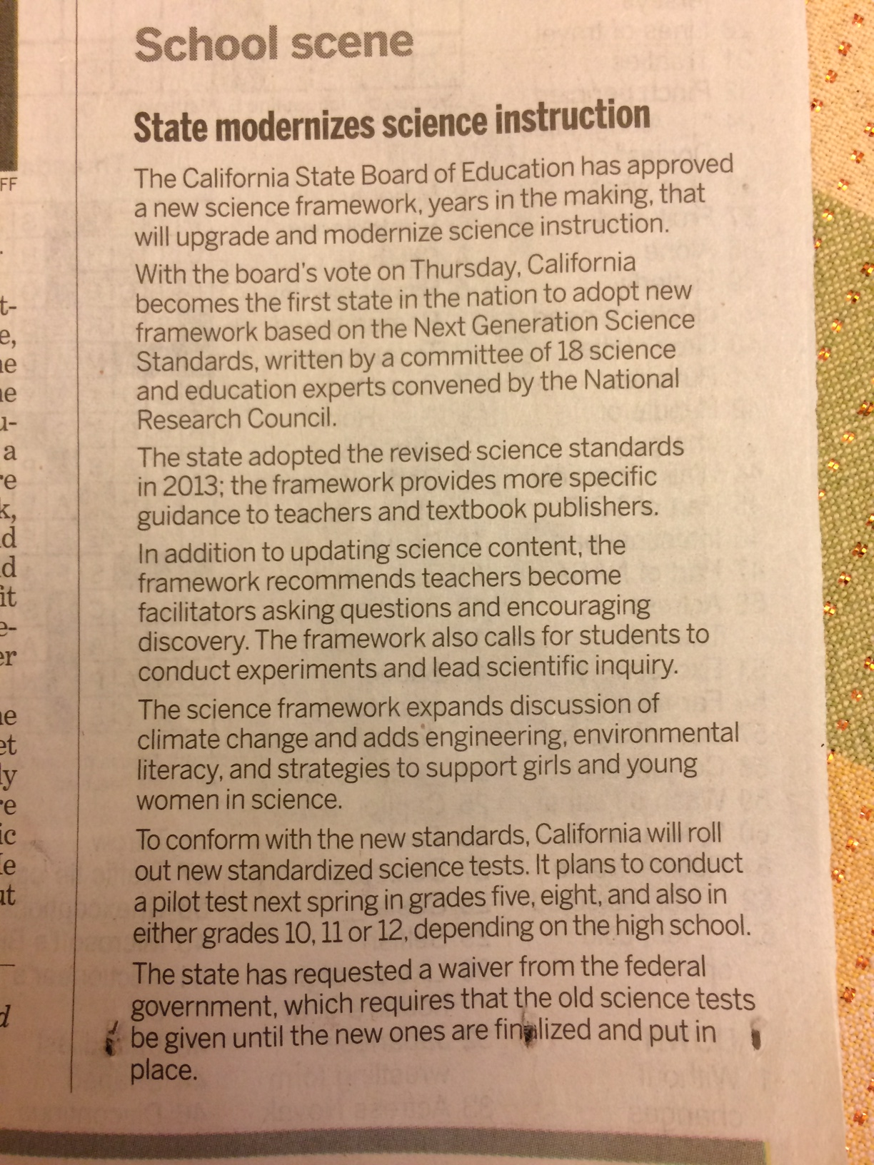
CA – first state to adopt
New framework, NGSS
Asking Questions
Conducting Experiments
Real-world problems
The Mercury News
Friday, Nov 4 2016

Slide 3
Why?
Building STEM proficient students begins in elementary school.
STEM proficient students are logical thinkers who are technologically, scientifically, and mathematically literate.

Slide 4


Goal
By the end of 5th grade,
Students will master grade level STEM content, practices and processes.
Students will integrate STEM concepts within other disciplines, answer complex questions and investigate global issues.
Students will be able to meet real-world problems by engaging in meaningful and relevant inquiry-based, problem-based and project-based learning experiences.

Slide 5
Grade 4 Physical Science Standards
Current “Old” Standards
focus on ‘knowing content’
Physical Sciences
1. Electricity and magnetism are related effects that have many useful applications in everyday life. As a basis for understanding this concept:
a. Students know how to design and build simple series and parallel circuits by using components such as wires, batteries, and bulbs.
b. Students know how to build a simple compass and use it to detect magnetic ef­ fects, including Earth’s magnetic field.
c. Students know electric currents produce magnetic fields and know how to build a simple electromagnet.
d. Students know the role of electromagnets in the construction of electric motors, electric generators, and simple devices, such as doorbells and earphones.
e. Students know electrically charged objects attract or repel each other.
F. Students know that magnets have two poles (north and south) and that like poles
repel each other while unlike poles attract each other.
g. Students know electrical energy can be converted to heat, light, and motion.

Slide 6
Grade 4 Physical Science Standards
NGSS – focus on ‘performance expectations’

Slide 7

Students knowing, connecting, and applying Science content across disciplinary boundaries and in their real-world lives
Practices “what we DO”
Cross-cutting Concepts
“how we THINK about what we DO”
Core Ideas “topic”
Questioning
Models
Investigations
Applied Math
Arguments from Evidence
Patterns
Cause – Effect
Scale, Proportion
Stability, Change
Systems
Life, Earth, Physical Science
Engineering Design

Slide 8
NGSS Science & Engineering
Practices
NGSS Science & Engineering
Cross-Cutting Concepts
Ask questions, define problems
Develop and use models
3. Plan and run investigations
4. Analyze and interpret data
5. Use math and computational thinking
Construct explanations and design solutions
Engage in argument from evidence
8. Obtain, evaluate, and communicate information
Patterns
Cause & Effect
Scale, Proportion, & Quantity
Systems & System Models
Energy & Matter
Structure & Function
Stability & Change

Slide 9
Students knowing, connecting, and applying Science content across disciplinary boundaries and in their real-world lives
Practices “what we DO”
Cross-cutting Concepts
“how we THINK about what we DO”
Core Ideas “topic”
Questioning
Models
Investigations
Applied Math
Arguments from Evidence
Patterns
Cause – Effect
Scale, Proportion
Stability, Change
Systems
Life, Earth, Physical Science
Engineering Design

